Slide 1
BA Airlines : Capturing Passenger Sentiments

Slide 2
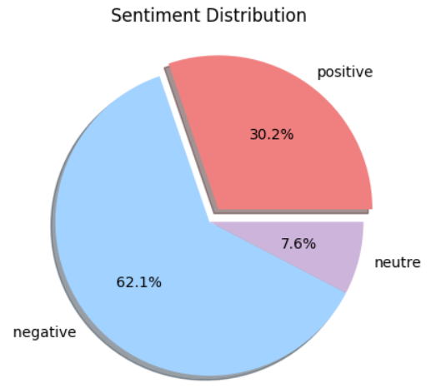
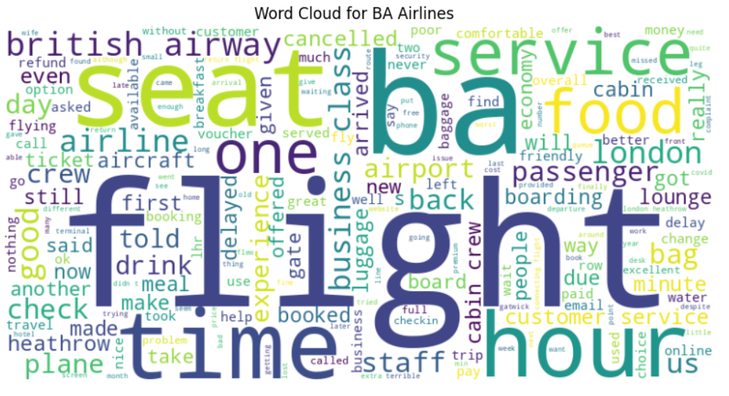
Key words:
The wordcloud below shows that the most frequent topics within reviews include ‘flight’, ’time’, ‘food’ ‘service’, ‘seat’. Showing that costumers are actively sharing comments about those topics.
Sentiment :
out of 981 reviews, 610 were negative, 296 positive and 75 neutral. This means that the majority of reviws were either positive or negative.

